Slide 1
2016 New Coder Survey data Analysis
Group Member: Chuyao Xiong

Slide 2
Goals of the project
Make some basic exploratory analysis based on the data set, including age, gender, income, city population, country of citizen, etc.
Predict the income given the age, gender, city population, country of citizen, months spent on programming.

Slide 3
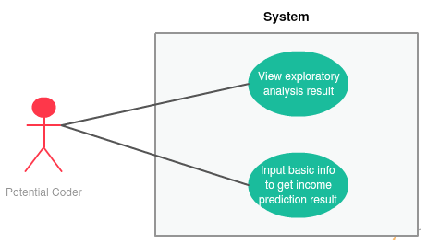
Use case

Slide 4
Methodology
Prepare: Pre-process the dataset using Spark, clean empty, miss format data from the dataset, and then extract data information that we need to use.
Exploratory Analysis: Statistical work using MapReduce and Spark.
Machine Learning Model: Multiple Linear Regression
Visualization: Zeppelin

Slide 5
Data sources
The data came from survey result of more than 15,000 people who are actively learning to code.
The data sources is a single csv format file, which covers participants’ individual responses to 48 questions, including their basic information, related experience and how did they learn coding.
Link: https://www.kaggle.com/freecodecamp/2016-new-coder-survey-

Slide 6
Milestones
Nov 7- Nov 13 | Set up project repository with required Spark plugins Pre-process the data
Nov 14- Nov 20 | Exploratory analysis Visualization
Nov 21- Nov 27 | Applying algorithms(ML model) Unit test cases
Nov 28- Dec 4 | Combine all parts together

Slide 7
Scala programming & Project repo
Spark
Implement machine learning model(MLlib)
UI design
Repo: https://github.com/xcyxcy1105/2016-New-Coder-Survey-data-Analysis

Slide 8
Acceptance criteria
Accomplish statistical work by drawing graphs of part of the columns in the table(age, gender, income, city population, country of citizen).
Successfully predict the income given related information in about 60% accuracy, show the results to customer.

Slide 9
Thank you!

